Slide 1
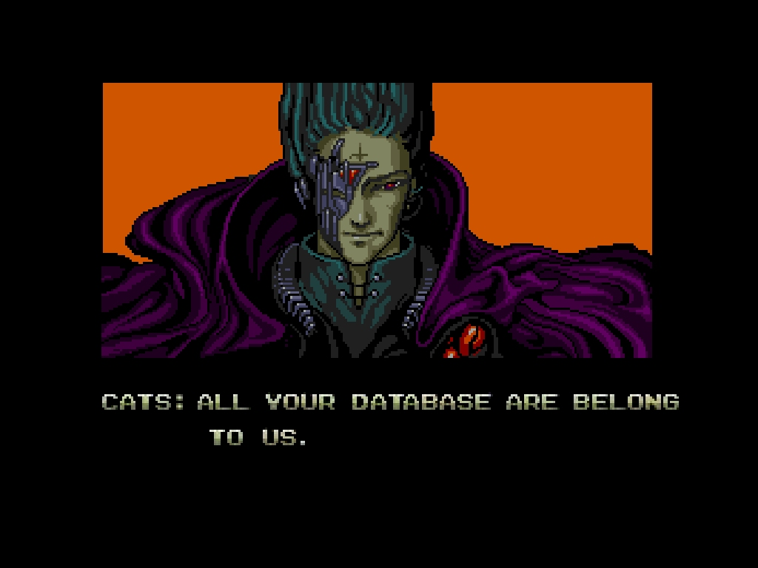

Slide 2
Geek culture and its role in active and experiential learning
Calvin Webster

Slide 3

About me
Technology Coordinator, Academic Community Service Learning Program - NCCU

Slide 4
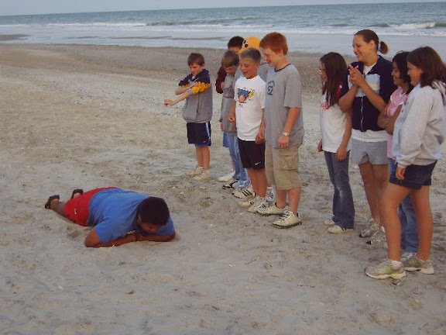
About Me

Slide 5
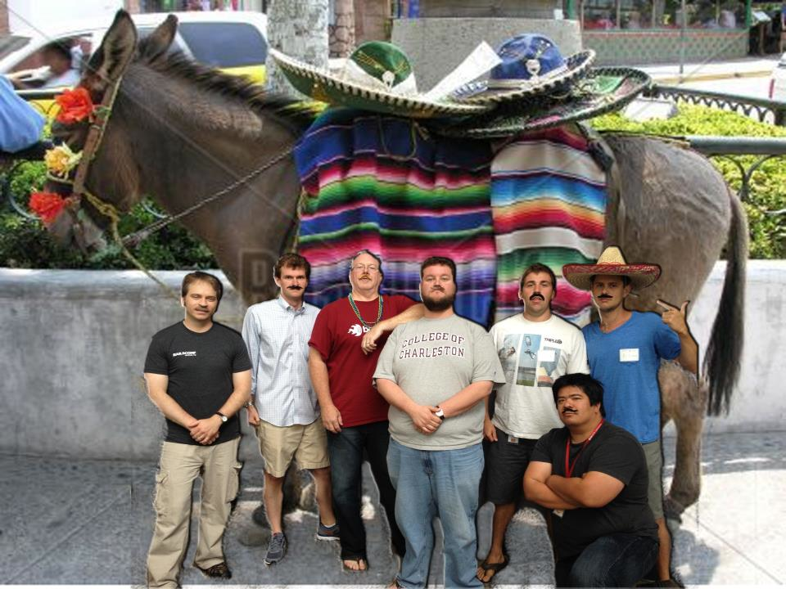
About me now
UI/UX at SPARC

Slide 6
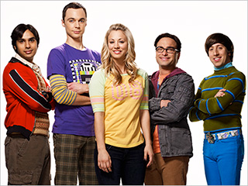
Overview of the Geek
Likes to know stuff
Might be opinionated
Is viewed as smart and cool
Doesn’t just like to play video games
Geeks are tribal

Slide 7
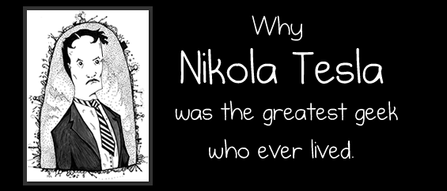
Geek Heros
- theoatmeal.com

Slide 8

Geek Heros

Slide 9

Geek Community

Slide 10
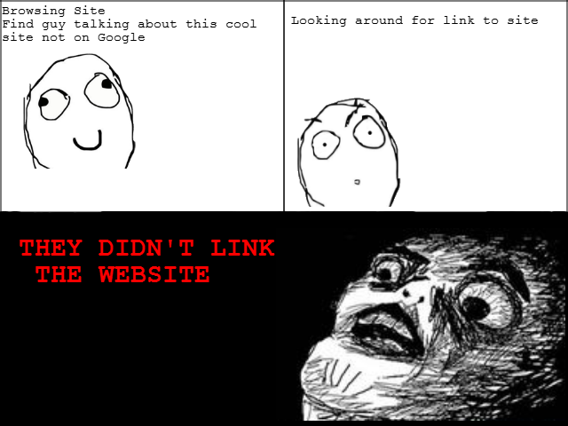

Slide 11
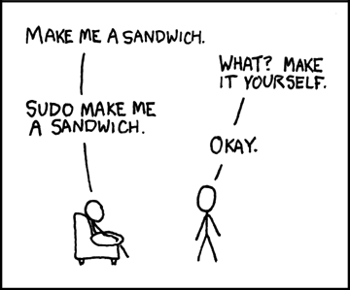
More humor

Slide 12
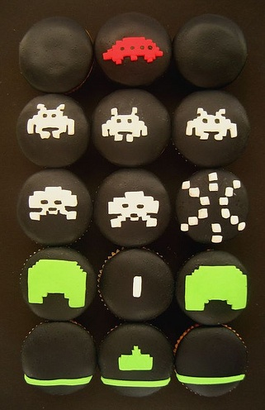
Geeks like to share
Open Source Software
User Groups
Barcamps

Slide 13






Open Source Software

Slide 14


User Groups
Super Happy Dev House
Lowcountry Bloggers
Palmetto Technology Hub
Charleston Drupal
Charleston Wordpress
Social Media Club

Slide 15

Barcamp Charleston
What is a Barcamp
Self Organizing
Diverse Topics
Active and Engaging

Slide 16
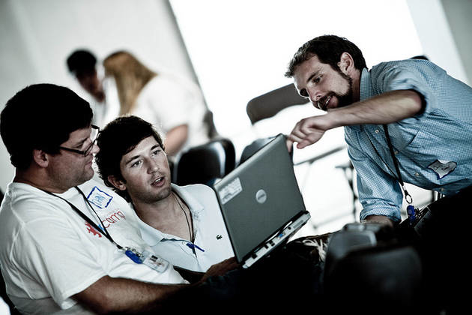
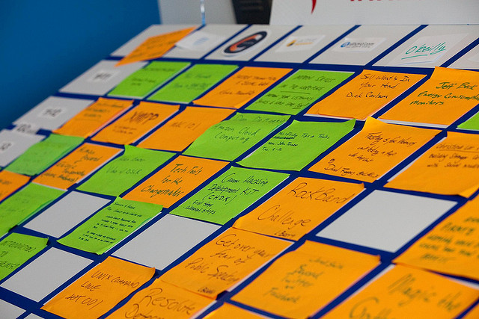
Learning…

Slide 17
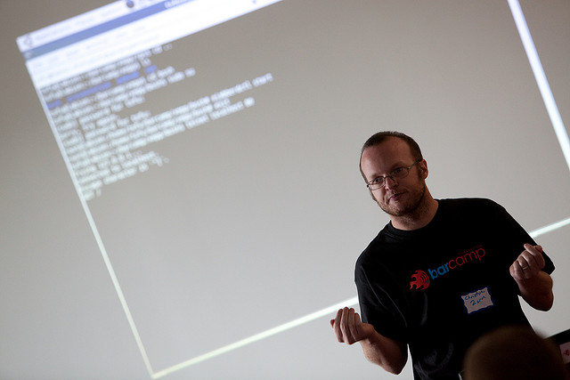

Slide 18
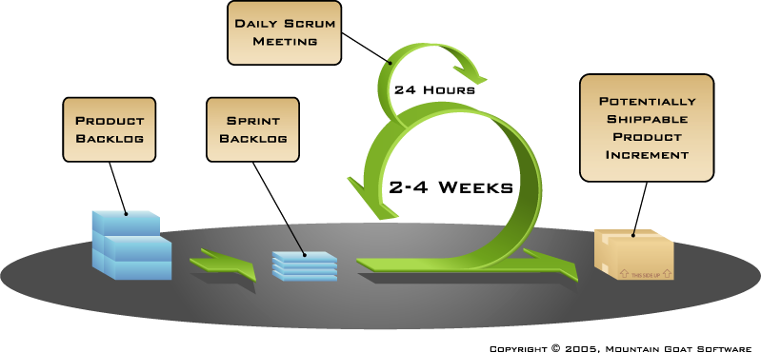
Scrum

Slide 19
Droppin some theory…
Constructivism
Interleaving
SERVICE-LEARNING
Tacit Learning
Informal and Postmodern
Transformative

Slide 20
Benefits of applying
More holistic approach
Community
Asset mapping
Caters to different styles
More engagement

Slide 21
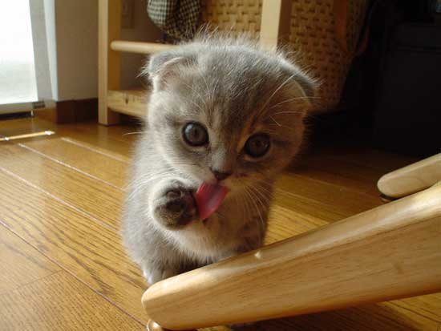
Thank you

Slide 22
Credits
All barcamp photos/graphics by Chrys Rynearson – http://exposur3.com
Others are Creative Commons

Slide 23
Barcampchs.org
My email:
calweb@gmail.com
Code/presentation for this conference:
http://github.com/calweb/cs4hs

